Slide 1
Crime PREDICTION & MONITORING FRAMEWORK BASED ON SPATIAL ANALYSIS
BY
T HITESH KUMAR REDDY
GUIDE:
MRS. BHAVNA SAINI
MRS. GINIKA MAHAJAN
Notes:
Slides 9,11,14 are videos.

Slide 2
Crime is one of the dangerous factors for any country.
Crime analysis is the activity in which analysis is done on crime activities.
Prediction of crime activities for a region can provide preventive measures for the police department.
The project provides such a scheme which can predict the number of criminal cases for future and this can help to take certain safety measures.
WHAT MAKES CRIME PREDICTABLE ?
As per studies conducted by University of California , It is observed that crime in any area follows the same pattern as that of earthquake aftershocks . It is difficult to predict an earthquake but once it happens ,the aftershocks following it are quite predictable. Same is true for the crimes happening in a geographical area.
On behavioral grounds, It is found that once successful ,Criminals try to replicate the crime under similar conditions. They tend to operate in their comfort zone, and hence , they look for similar location and time for the next time. This makes them predictable.

Slide 3
RELATED WORK
Lot of research work is done by various researchers in this domain. The existing work is limited to use the datasets to identify locations of crime. But none of them considered that the type of crime, date of crime as the factor. Yu, R et. al provides the static maps with no interactive features [8].
To overcome these limitations, the proposed framework provides the visualization techniques that consider the type of crime to identify the crime hotspots and helps to check these locations with the interaction features using Google maps .
Few papers focused on usage of decision trees for crime prediction [4] [13][14]. Ahishakiye et. al and Iqbal et. al, used the attributes population of country, Median Household income, percentage of people who are unemployed with age greater than 16, type of crime, etc. which only predicts whether in an area there will be high, medium or low percentage of violent crimes that can happen in future. The methods proposed by them didn’t predict the type of crime that can happen [4] [14]. Nasridinov et. al also proposed a method for classifying the crime rate as high, medium or low.
None of them has classified the type of crime that can happen and its probability of happening. Further, all used the decision trees which provide the information of which parameters of the dataset are important for the study. Further, it predicts the crime of a location if the information of location is available in the dataset. For example, if a crime happened at a location with latitude=-2.44 and longitude=50.35, the previous related provides the information of future happening of crime at this location only but cannot predict at a location with latitude=-2.3 and longitude=50.4. By using the nearest neighbour approach (k-nn), this paper is able to overcome the mentioned problem.

Slide 4
Data Collection
Data collected from UK Police database.
Data Preparation
Required information for prediction is extracted.
Data Visualization
Using R and Google libraries the interaction plots are made.
Prediction
Using various prediction algorithms to predict future crimes.

Slide 5
DATA Collection
THE DATA HAS BEEN COLLECTED FROM THE OFFICIAL SITE OF UK POLICE DEPARTMENT (https://data.police.uk/data).
THE DATA HAS SOME OF THE FOLLOWING ATTRIBUTES:
CRIME ID , LOCATION , LATITUDE , LONGITUDE , CRIME TYPE , MONTH , Police STATION AREA etc.
DATA PREPARATION
THE USEFUL ATTRIBUTES WHICH ARE REQUIRED FOR PREDICTION WERE EXTRACTED
AND THE MISSING DATA ROWS WERE REMOVED TO MAINTAIN THE CONSISTENCY
Notes:
Data cleaning has been done through some manual effort and by some R program using tidyR library.

Slide 6
DATA VISUALISATION
“A picture is worth a thousand words.”
THIS PAPER PROVIDES A PLATFORM TO VISUALIZE THE FOLLOWING WITH THE DATA THAT IS AVAILABLE IN THE DATASETS
AREA-WISE CRIME THAT HAPPENED
AREA WHERE THE CRIME HAPPENED
MAP PLOT WITH HIGHEST CRIME FREQUENCY
CATEGORY WISE PLOTING
MONTH WISE CRIME REPORT
Notes:
Libraries RgoogleMap, googleVis , ggmap , ggplot2 for visualisation

Slide 7
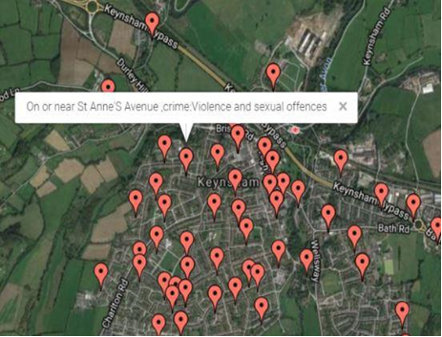
Areas with recent crimes
The figure shows the locations where the most recent crimes have happened. We can see from the picture that crimes happened are clustered , are very near to each other.
we can analyse that if a location feasible to an crime attack, then the locations near to those are also feasible for the attack.
Notes:
The picture has been generated through R program by using the RgoogleMap library.

Slide 8
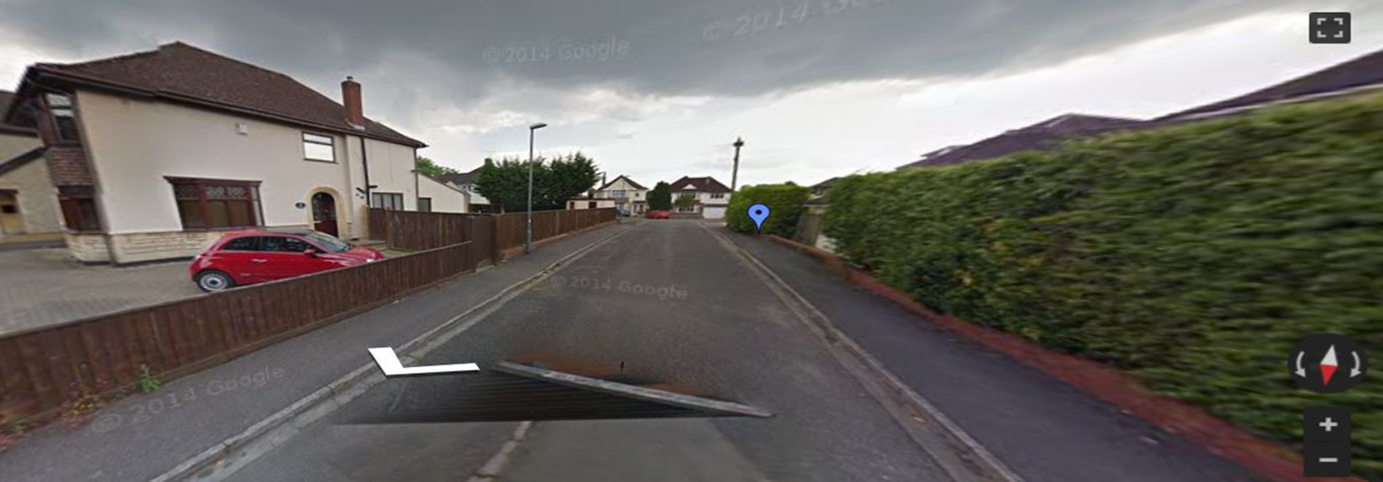
The Area where the Crime Happened
The figure visualises the area where the crime has happened. This is an interactive image which takes help of Google Maps to navigate around the crime location and it can help the analyst to analyse the security of an area, can also analyse how the criminals may have escaped and what locations can be the target for next attack.
Notes:
The picture has been generated through R program by using the RgoogleMap library.

Slide 9
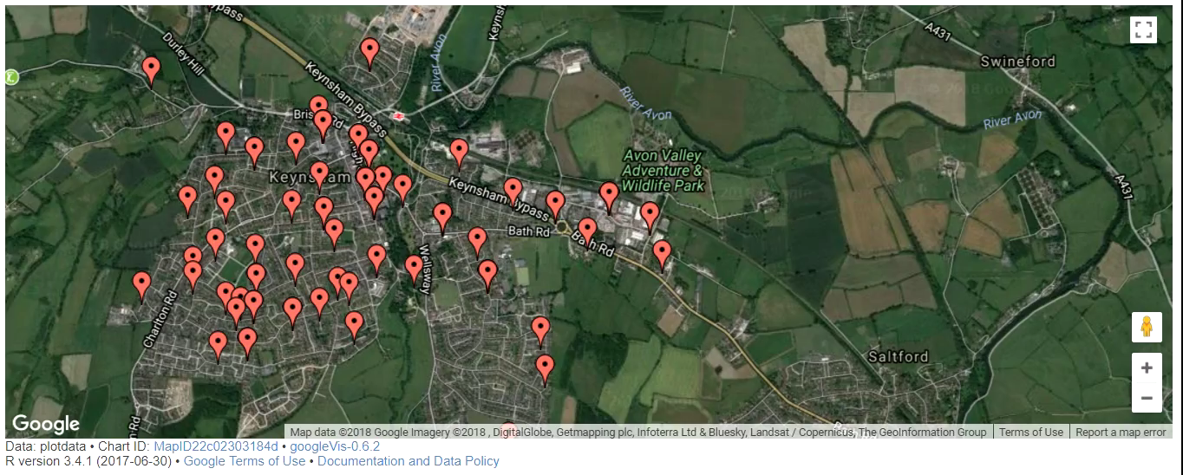
Notes:
This is a video.
It’s a screen capture.

Slide 10
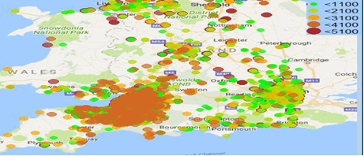
Frequency Map- Showing the areas with A given Range OF NUMBER OF CRIMES
The picture is the crime density map which shows the frequency of crimes happened in an area. The picture visualises the areas based on the number of crimes that happened in an area. The areas with less frequent crimes are displayed in the green colour, and the areas with more frequent crimes are displayed in Red colour.
Notes:
The picture has been generated through R program by using the ggmap library

Slide 11
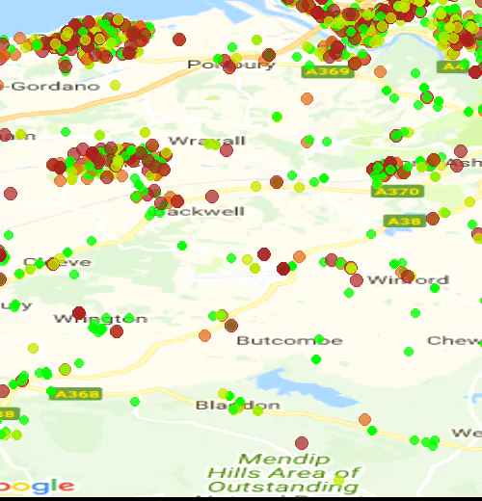
Notes:
This is a video. Generated by R program using ggmap library.
Some points, Before they is red color ie around 5000 crimes has happened, after some moths if changed to green ie around 1000 crimes,
This means that crimes have been decreased in that area

Slide 12
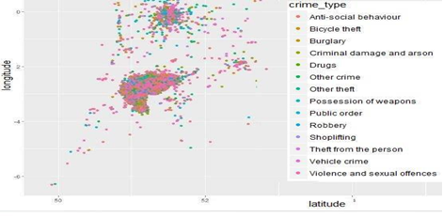
Areas with the Specified TYPE OF Crime That Happened
The Figure visualises the areas where the crime happened along with the type of crime. This helps to visualise what type of crime is happening more and the hotspots based on the type of crime. We can see that the colour pink is more in the picture which says that Anti-social behaviour crimes are more frequently reported.
Notes:
The picture has been generated through R program by using the ggmap library

Slide 13
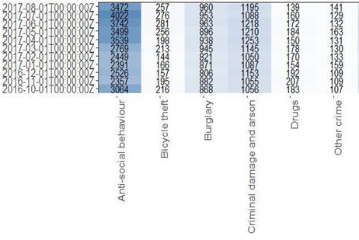
Calendar plot Representing the frequency of Crimes by month
The picture is the reported generated from the available data. This visualizes the no of crimes reported in a month based on the category. This is the numerical data which gives the idea how the crimes are trending.
Notes:
The picture has been generated through R program by using the ggplot2 library

Slide 14
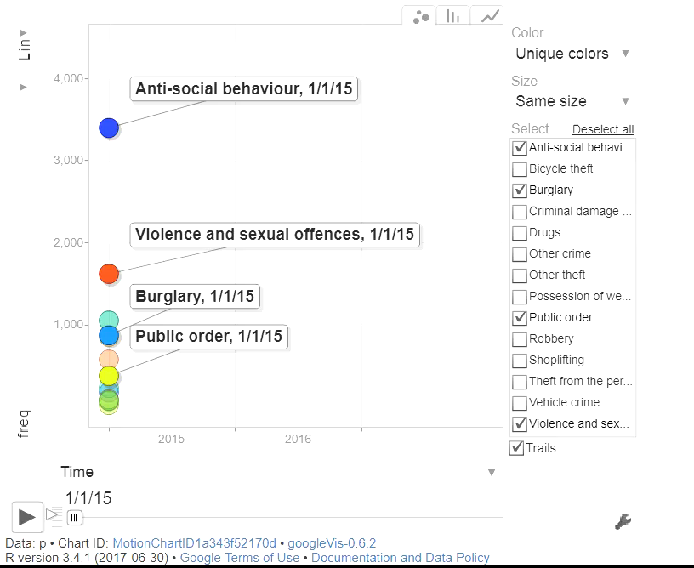
Changes in frequency of crimes by Months
Notes:
The video has been generated through R program by using the googlvis library

Slide 15
Model planning
As we are dealing with the crime data and the outcome is prediction of type of crime, so we decided to use the classification algorithms. we decided to use the supervised learning algorithms as this involves learning the datasets which is past data.
Model BUILDING
As per the decisions in the model planning we decided to use the following learning algorithms.
K-NEAREST NEIGHBOURS
NAÏVE BAYES ALGORITHM
Notes:
The e1071 library was used for applying K-nn algorithm,
The “class ” library was used for applying the NaiveBayes algorithm.

Slide 16
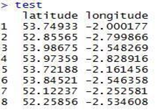
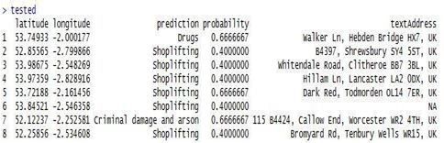
1. k-nearest neighbor (k-nn)
K nearest neighbors is a simple algorithm that stores all available cases and classifies new cases by a majority vote of its k neighbors[ ] . The case being assigned to the class is most common amongst its K nearest neighbors measured by a distance function.
The Test Data
PREDICTIONS BY K-NN ALGORITHM

Slide 17
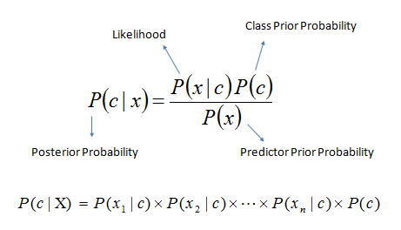
3. Naive Bayes
Naive Bayes classifier assumes that the presence of a particular feature in a class is unrelated to the presence of any other feature.
Naive Bayesian model is easy to build and particularly useful for very large data sets.
Along with simplicity, Naive Bayes is known to outperform even highly sophisticated classification methods.
Bayes theorem provides a way of calculating posterior probability P(c|x) from P(c), P(x) and P(x|c). Look at the equation below:
Here,
P(c|x) is the posterior probability of class (target) given predictor (attribute).
P(c) is the prior probability of class.
P(x|c) is the likelihood which is the probability of predictor given class.
P(x) is the prior probability of predictor.

Slide 18
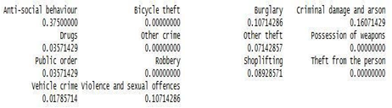
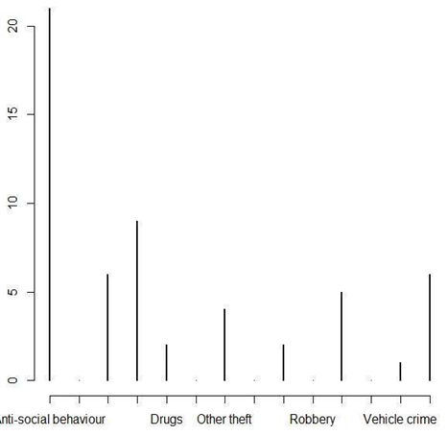
on Applying the Naive Bayes algorithm we obtained the following probabilities of type of crime that can happen at location with latitude=51.512191,longitude=-2.2473371 which is
"B4039, Chippenham SN14, UK"
The pictures shows the computed probabilities in graphical representation.

Slide 19
REFERENCES
Ihaka, R. (1998). R: Past and future history. Computing Science and Statistics, 392396.
Wang, B., Zhang, D., Zhang, D., Brantingham, P. J., & Bertozzi, A. L. (2017). Deep Learning for Real Time Crime Forecasting. arXiv preprint arXiv:1707.03340.
Loecher, M. (2014). RgoogleMaps: overlays on Google map tiles in R. See http://cran. r-project.org/web/packages/RgoogleMaps/index. html.
Ahishakiye, E., Taremwa, D., Omulo, E. O., Nairobi-Kenya, G. P. O., & Niyonzima, I. (2017). Crime Prediction Using Decision Tree (J48) Classification Algorithm. analysis, 6(03).
Gesmann, M., & de Castillo, D. (2011). Using the Google visualisation API with R. The R Journal, 3(2), 40-44.
Kahle, D., & Wickham, H. (2013). ggmap: Spatial Visualization with ggplot2. R Journal, 5(1).
U.K. Crime data, https://data.police.uk/data/
Yu, R., Song, M., & Cui, E. San Francisco Crime Analysis and Classification.
https://www.theguardian.com/uk-news/2017/oct/19/rising-at-increasing-rate-in-england-and wales-police-figures-show.
https://en.wikipedia.org/wiki/Crime_hotspots
https://en.wikipedia.org/wiki/Routine_activity_theory
https://en.wikipedia.org/wiki/Rational_choice_theory_(criminology)
Nasridinov, A., Ihm, S. Y., & Park, Y. H. (2013). A decision tree-based classification model for crime prediction. In Information Technology Convergence (pp. 531-538). Springer, Dordrecht.
Iqbal, R., Murad, M. A. A., Mustapha, A., Panahy, P. H. S., & Khanahmadliravi, N. (2013). An experimental study of classification algorithms for crime prediction. Indian Journal of Science and Technology, 6(3), 4219-4225.
https://en.wikipedia.org/wiki/Data_analysis
https://www.slideshare.net/socialmediadna/predictive-policing-the-role-of-crime-forecasting-in-law-enforcement-operations

Slide 20
THANK YOU
Notes:
Phone no: 7726054801

